Slide 1
Employee Data Analysis Using Excel
Name: Preethi S
Register No: asunm161312203212
College: Prince srivenkateswara arts and science college

Slide 2
Project Title
Employee Data Analysis Using Excel

Slide 3
Agenda
Problem statement
Project overview
End users
Our solution and proposition
Data set description
Modelling approach
Result and discussion
Conclusion

Slide 4
Problem statement
Organisational development
Goal alignment
Motivation and engagement
Decision making
Accountability
Resource allocation
Organizational health
Legal protection

Slide 5
Project overview
An employee performance analysis project typically involves the systematic evaluation of employees’ work, behaviors, and outcomes to enhance organizational productivity and employee development.

Slide 6
Who are the end users?
Employee
Employer
Organisation
Human resources
IT development

Slide 7
Our solution and it’s value proposition
Flitering- Missing Value
Graph- visualisation
Pivot table – Summary

Slide 8
Dataset Description
Employee Database- kaggle
26 features
9 features
Name
Gender
Business unit
Performance
Rating
Employee id

Slide 9
Wow in our solution
Customization: Tailor the solution to fit the workflows and preferences of the specific departments or roles that will use it. For example, if the HR team is the primary end user, the solution should focus on ease of managing employee data, generating reports, and conducting performance reviews.
User Adoption: Engage with the end users early in the process to get their input and buy-in. This increases the likelihood of successful adoption, as they feel the solution is built with their needs in mind.
Feedback Integration: Establish a feedback mechanism where end users can report issues or suggest improvements. This allows the solution to evolve based on real-world usage and ensures it remains relevant and effective.

Slide 10
Modelling
. Define the Objectives
Identify Goals: Determine what you want to achieve with the analysis. Common goals include improving employee performance, reducing turnover, identifying training needs, or enhancing engagement.Specify Key Metrics: Decide on the metrics to be analyzed, such as productivity, attendance, employee satisfaction, or turnover rates.
Collect Data
Determine Data Sources: Identify where the relevant data will come from, such as HR systems, payroll, performance reviews, employee surveys, and attendance records.

Slide 11
Data Gathering: Collect the necessary data, ensuring it is accurate, comprehensive, and up-to-date. This might involve exporting data from software systems or conducting surveys.
Ensure Data Privacy: Comply with data protection regulations (e.g., GDPR) by anonymizing data and securing sensitive information.
Clean and Prepare Data
Data Cleaning: Address any data issues such as missing values, duplicates, or inaccuracies. Clean data is essential for reliable analysis.
Data Standardization: Convert data into a consistent format, especially if it’s coming from multiple sources. This may involve standardizing date formats, categorizing responses, or normalizing data ranges.

Slide 12
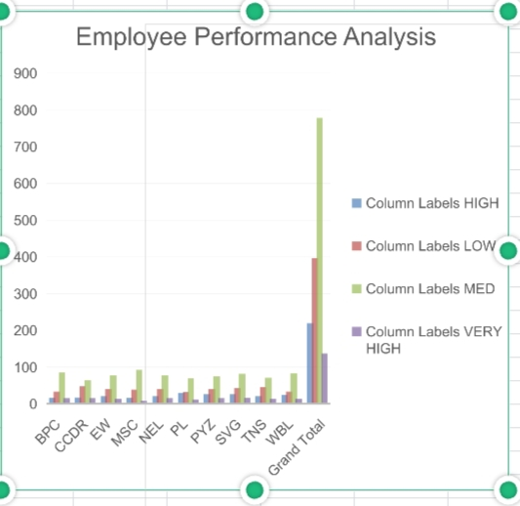
Result

Slide 13
Conclusion
A number of employees are underperforming relative to their peers. This may indicate gaps in skills, training needs, or other barriers to productivity.

